Slide 1



Yosemite: Efficient Scheduling of Weighted Coflows in Data Centers
Han zhang
Xingang Shi, Vaneet Aggarwal, LanTian
Tsinghua University, AT&T Lab, George Washington University

Slide 2
Index
Background
Yosemite Algorithm
Yosemite System
Evaluation
Discussion
Motivation

Slide 3
Background
Transport in Datacenters
Coflow Definition
Related Work

Slide 4

Transport in Datacenters
DC network interconnect for distributed compute workloads
latency is King traditional “fairness” metrics less relevant
Applications share data center network
web
vRouter
Druid
db
map-reduce
storage
Event

Slide 5
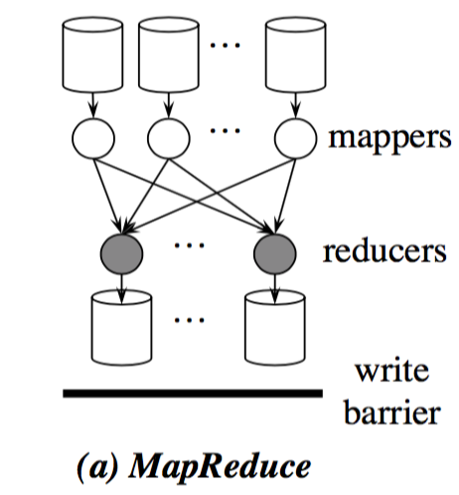
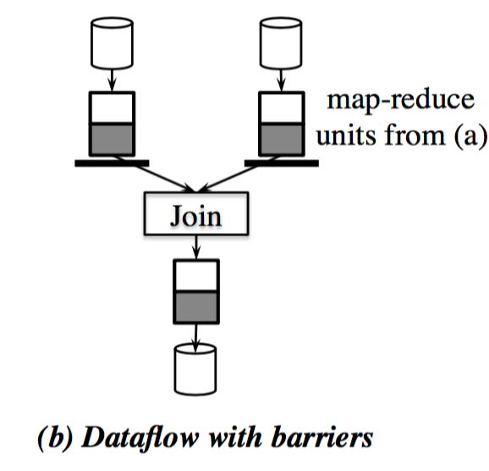
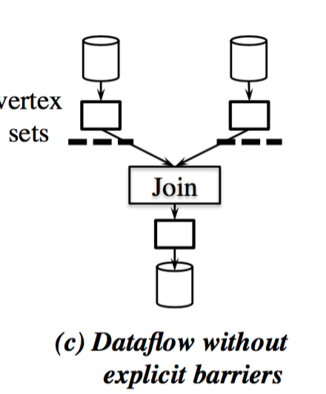
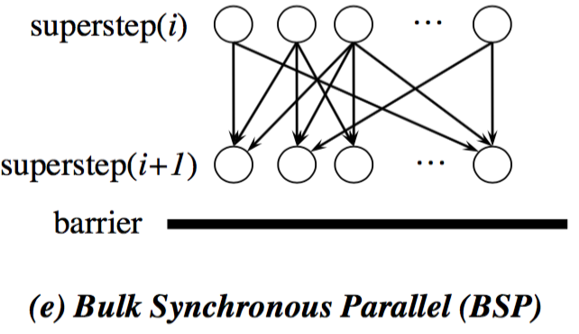
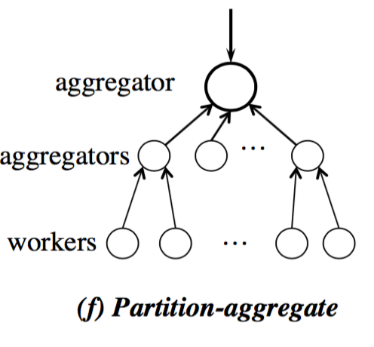
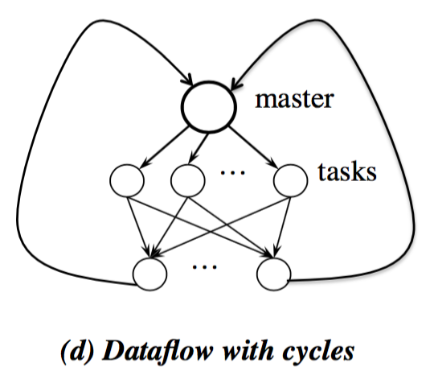
Coflow Definition
Coflow:
Collection of flows between two groups of machines with associated semantics and a collective objective.
Map-reduce, distributed storage, web search…
Not an application, but an abstraction

Slide 6
Related Work
Optimization goal
minimize average coflow completion time
Methods
Minimize flow completion time (or flow deadline miss)
DCTCP, D2TCP, PDQ, pFabric, PASE,LPD…
Minimize coflow (task) completion time
Varys, Barrat, Aalo, CODA, Sunflows…
Reality
Applications have different emergence
Coflow emergence should also be taken into consideration
Emergence + average coflow completion time

Slide 7
Motivation (ICNP17 Poster)
Datacenter Measurement
Methods Compare

Slide 8
Measurement in Datacenters
Applications and their emergence level in one of AT&T cloud (60 racks, 720 servers,1month)
App Name | Type | width | length (MB) | Emergence Level
Event | communication | 20 | 5 | significant
vRouter | communication | 8 | 3 | significant
Druid | interactive | 6 | 18 | important
Hadoop | communication | 5 | 42 | normal
Web | interactive | 3 | 5 | normal
VoltDB | background | 4 | 21 | normal
Hive | background | 7 | 32 | unimportant
Redias | background | 2 | 30 | unimportant
data-backup | background | 3 | 124 | lax
data-dist | background | 5 | 93 | lax

Slide 9
Methods Compare
Significant | event, vRouter | perform worse
Important | Druid | almost same
normal | Hadoop, web, VoltDB | almost same
Unimportant | Hive, Redias | almost same
Lax | data-back, data-distr | perform better

Slide 10
Measurement in Datacenters

Slide 11
Methods Compare
Significant coflows perform even worse
Lax coflows perform better
Schedule weighted coflows !!!

Slide 12
Yosemite Algorithm
Network Model
Algorithm-discussion
Problem Formulation
Performance Loss

Slide 13
DC Fabric: Just a Giant Switch
H1
H2
H3
H4
H5
H6
H7
H8
H9

Slide 14
DC Fabric: Just a Giant Switch
H1
H1
H1
H2
H2
H2
H3
H3
H3
H4
H4
H4
H5
H5
H5
H6
H6
H6
H7
H7
H7
H8
H8
H8
H9
TX
H9
H9
RX

Slide 15
DC Fabric: Just a Giant Switch
H1
H1
H2
H2
H3
H3
H4
H4
H5
H5
H6
H6
H7
H7
H8
H8
TX
H9
H9
RX

Slide 16
DC transport = coflow scheduling on giant switch
Ports have unit capacity
Flows contend at ports only
H1
H1
H2
H2
H3
H3
H4
H4
H5
H5
H6
H6
H7
H7
H8
H8
TX
H9
H9
RX
ingress & egress
capacity constraints

Slide 17
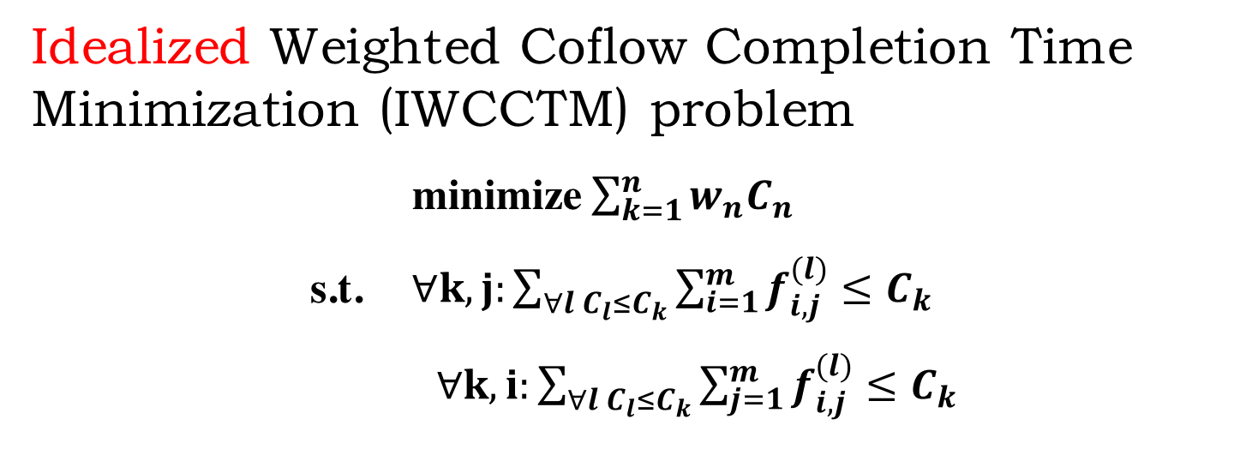
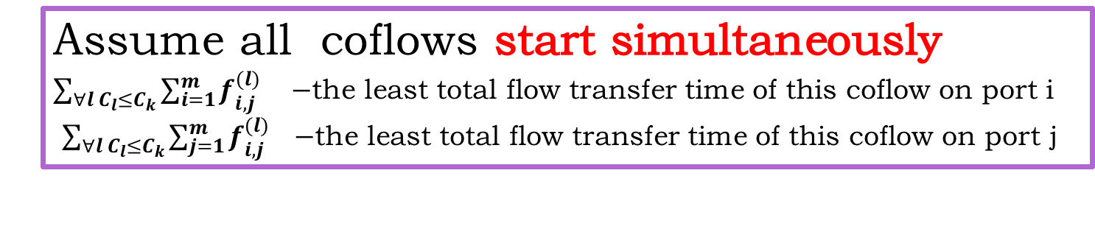
Problem Formulation
Idealized Weighted Coflow Completion Time Minimization (IWCCTM) problem
minimize $\sum_{k=1}^{n}{w_{n}C_{n}}$
s.t. $∀k,j:\sum_{∀l C_{l}≤C_{k}}{\sum_{i=1}^{m}{f_{i,j}^{(l)}≤C_{k}}}$
$∀k,i:\sum_{∀l C_{l}≤C_{k}}{\sum_{j=1}^{m}{f_{i,j}^{(l)}≤C_{k}}}$
Assume all coflows start simultaneously
$\sum_{∀l C_{l}≤C_{k}}{\sum_{i=1}^{m}{f_{i,j}^{(l)} } } −$the least total flow transfer time of this coflow on port i
$\sum_{∀l C_{l}≤C_{k}}{\sum_{j=1}^{m}{f_{i,j}^{(l)} } }−$the least total flow transfer time of this coflow on port j

Slide 18
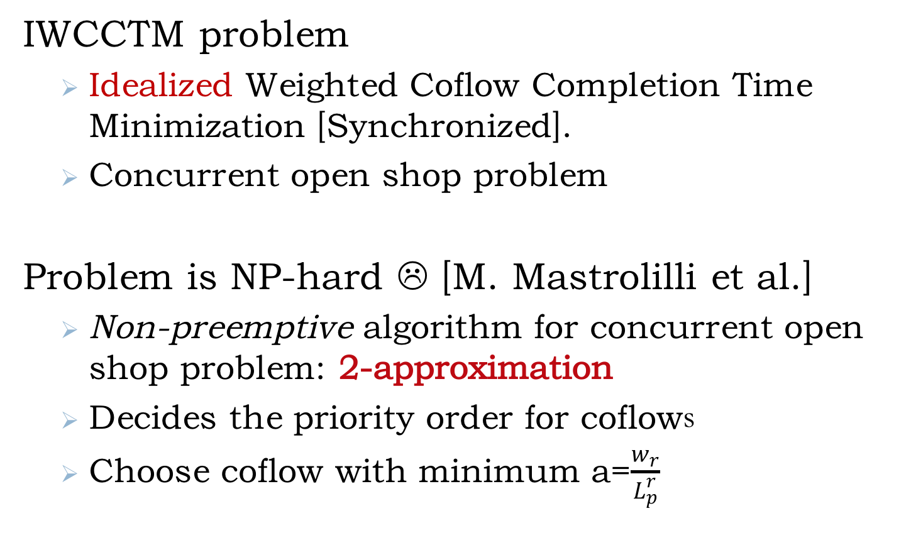
2-approximate offline method
IWCCTM problem
Idealized Weighted Coflow Completion Time Minimization [Synchronized].
Concurrent open shop problem
Problem is NP-hard ☹ [M. Mastrolilli et al.]
Non-preemptive algorithm for concurrent open shop problem: 2-approximation
Decides the priority order for coflows
Choose coflow with minimum a=$\frac{w_{r}}{L_{p}^{r}}$
Notes:
State explicitly that you can’t actually build this in practice the way it is described
Central, etc

Slide 19

2-approximate offline method
1
1
f¹_{(3,1)+}f²_{(2,1)}
f¹_{(1,3)+}f²_{(1,2)}
1
1
2
$$α=\frac{w}{L_{p}^{i}}$$
2
2
f¹_{(2,2)+}f²_{(1,2)}
f¹_{(2,2)+}f²_{(2,1)}
2
2
3
3
f¹_{(1,3)+}f²_{(3,3)}
f¹_{(3,1)+}f²_{(3,3)}
1
All coflows at the same time
Should know flow size beforehand
Notes:
State explicitly that you can’t actually build this in practice the way it is described
Central, etc

Slide 20
From offline to online
Simple offline algorithm
Date center are expected to be load balanced
Ignores the port load difference, and just prioritize coflows with large weight but small load
Information-agnostic Online scheduling
Flow sizes can not be known beforehand
Use size that has been sent instead
Shortest Coflow First heuristic

Slide 21
Performance loss
average WCCT: 10% loss
Significant: 30% loss
Important: 25% loss
Distribution: 30% gap
30% loss on average

Slide 22
Yosemite System
Key Insight
API
System
Demo

Slide 23

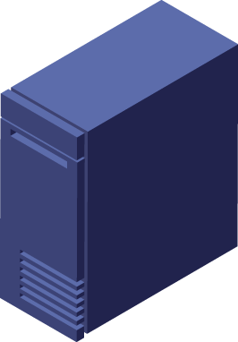
Key Insight
Centralized control method
computes coflow priority and rate of each coflow
“brain”
Traffic shape
Coflow info collector
a
H1
H2
H3
H4
H5
H6
H7
H8
H9

Slide 24
System
Master
Computes coflow priority
Computes flow bandwidth
Client
Interacts with applications
Only at ends
Slave
Rate control
Communications
H1
H2
H3
H4
H5
H6
H7
H8
H9

Slide 25
System
Actor Model
Different actors do different things
Akka: used to communication
Information backup (master backup) and restart quickly（～23ms)
Fault-tolerant (Akka)
Easy to deploy
Provide API
……

Slide 26
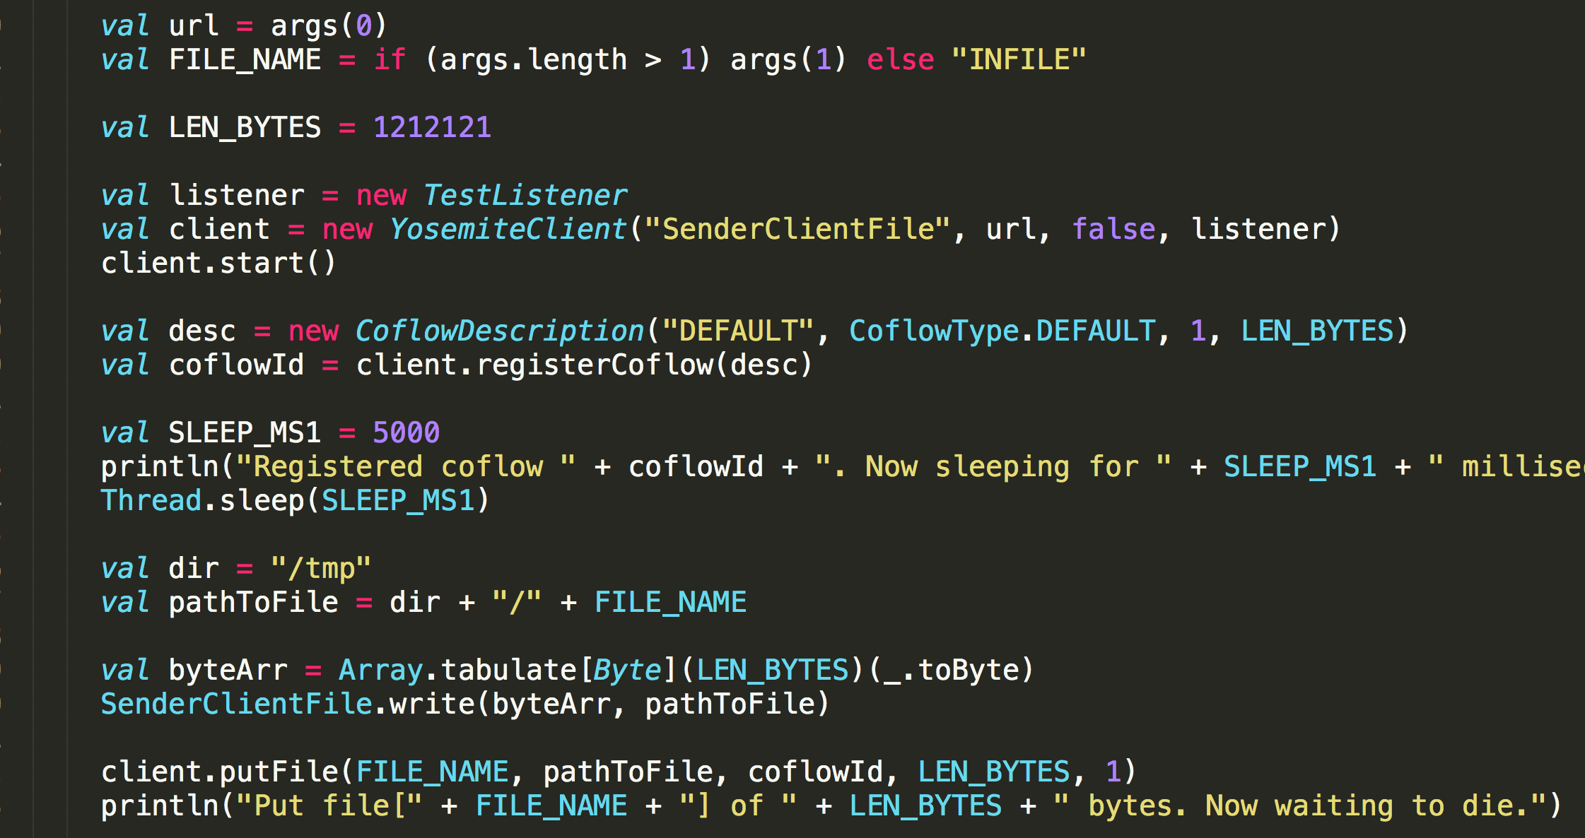
API
Yosemite provides API to users
Name | Parameters | Return | Description
RegisterCoflow | coflowdesc,weight | coflowId | Register a coflow
Send | coflowId, dst | bool | send data to a dst
Reveive | coflowId | bool | receive a flow
ReleaseCoflow | coflowId | bool | release coflow
Declare a client
Register a coflow
Send a flow

Slide 27
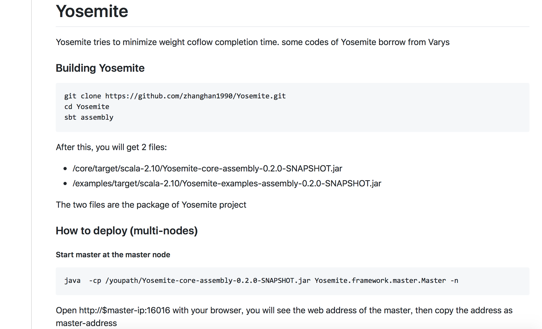
Open Source
https://github.com/zhanghan1990/Yosemite

Slide 28
Evaluation
Motivation Resolved
Facebook Traffic
Testbed

Slide 29
Motivation Resolved
2X
1.5X
1.8X
1.2X

Slide 30
Facebook Traffic
2.2X
1.8X
2.1X
1.7X

Slide 31
Testbed
2X
2X
2X
2X

Slide 32
Testbed
1.8X
~23ms

Slide 33
Discussion
We are the first to take the emergence of coflow into consideration
We design Yosemite – the first non-clairvoyant schedule system for weighted coflows.
Experiments show Yosemite performs at least 2X better than the state-of-art methods.
Need improvement in the future…
Thank You !

